Slide 1
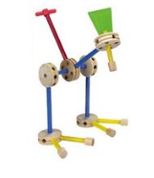
A $20 FPGA kit Boot Camp for Digital Systems Education
Jim Brakefield jim.brakefield@ieee.org
IEEE Computer Society
Notes:
Tinker toy (or LEGO block) construction embodies the generation/design of abstract objects from simple uniform components

Slide 2
Preliminaries
Funding provided by a grant from the IEEE Computer Society as part of their Emerging Technologies program
I’m Jim Brakefield, jim.brakefield@ieee.org
Full set of files at: https://github.com/jimbrake/20-dollar-FPGA-kit
Introduction to FPGA video: https://www.youtube.com/watch?v=EVy4KEj9kZg

Slide 3
FPGA Video Tutorials
There are a wealth of youtube videos on these subjects including whole sets of videos
https://nandland.com/fpga-101/ and
https://www.youtube.com/watch?v=CfmlsDW3Z4c
https://www.youtube.com/watch?v=OUNrGLgx9h4
Recommended
My favorite FPGA video series:
https://www.youtube.com/@SimplyEmbedded/videos
https://www.youtube.com/@SimplyEmbedded/playlists

Slide 4
My view of binary
Zero and ones: One names a single such signal or a group of such signals (subscripted by bit number)
A binary number is a polynomial:
A[n-1]x^{n-1} + A[n-2]x^{n-2} + … A[1]x¹ + A[0]x⁰
Where X = 2, and A[n] are 0 or 1 bits from the number. If A[n-1] is 0/-1 then it is 2’s complement and negative if A[n-1] is -1.
It is typical for the bit numbers to run from N-1 to 0 where N is the number of bits.
Adding or subtracting 2’s complement wraps around in a circle where the most positive and most negative numbers are adjacent (any carry or borrow beyond x^{n-1} is discarded).
Windows calculator has binary features: https://www.youtube.com/watch?v=PK5WQqN3_44
Notes:
The youtube video covers all the calculator features including radix (binary, hex, decimal) and the binary operations (AND, OR, XOR, shifts and rotate).

Slide 5
The $20 FPGA Kit agenda
To make the FPGA experience available to all
Very few FPGA boards for under $20
The Tang 9K Nano board has:
8,640 LUTs
HDMI connector
SD card slot
8MB DRAM
$15 price tag
Notes:
The LUT count, DRAM and SD card slot means that the board can be used for soft core processors such as 6502, Z80, AVR etc. The SD card can be used as a disk file device supporting an operating system. https://www.cnx-software.com/2022/01/17/tang-nano-9k-fpga-board-can-emulate-picorv32-risc-v-soft-core-with-all-peripherals/

Slide 6
The $20 FPGA Kit agenda
The Tang 9K FPGA board does not have:
7-segment digits
Only two push buttons
No slide switches
Use add-on components:
Display board $2.90
DIP switch $0.88
Solderless breadboard $6.69 for 4
Male-female jumper wires $1.95 for 40
See the *.xlsx or PDF for part BOM web links
Notes:
The pro-rata cost of the breadboard and DIP switch drop in quantity to approximately $1.70 for a total kit price of $18.51. In very large quantities further reductions possible. The goal here is an under $20 kit price so almost any student or any school can afford a kit(s). The single kit price with some extra parts is $25.64 plus shipping and taxes.

Slide 7
The $20 FPGA Kit agenda
Supplement the Tang 9K Nano FPGA board:
Display board: $2.90
12 position DIP switch $1.06 for one
Solderless bread board $6.69 for four
Will require some user wiring
Insulated 22 gauge jumper wire
Five or more male-female jumper wires
or replacing display board pins with jumper wires
Pins on Tang FPGA board require soldering
And learning the Nano board software tools
VHDL, Verilog and constraint files supported.
Notes:
The Digital simulator can be used to generate the VHDL or Verilog (https://github.com/hneemann/Digital/). However, the constraint file needs to be edited or entered via Gowin constraint editor.

Slide 8
Display board tm1638-7-segment-display-keypad-led-module
Provides:
8 7-seg digits
8 discrete LEDs
8 push buttons
for $2.90
Notes:
Uses 4 volt driver chip, should work at 3.3 volts? Driver chip uses a SPI like interface. VHDL/Verilog example web links on sheet titled “RTL for driving display”.

Slide 9
DIP Switch
Twelve position DIP switch gives best cost/ benefit ratio.
For use on breadboard will need to fold out every 6th pin.
Notes:
Individual slide switches are relatively expensive. For best connections to breadboard use DIP switches with full size pins (shown). To reclaim folded out pins solder a fine wire up and down the fold-out side (normally connected to ground).

Slide 10
Solderless Breadboard
Best deal in quantity three
or sixteen
The DIP switch
to straddle
ground column
and signal rows
Sufficient size to hold Tang Nano and DIP switch
Notes:
As the ground column has breaks every six spaces, will fold the DIP switch pins out for those positions; or use two five position DIP switches.
Longer versions of the breadboard available or double this module for more space.

Slide 11
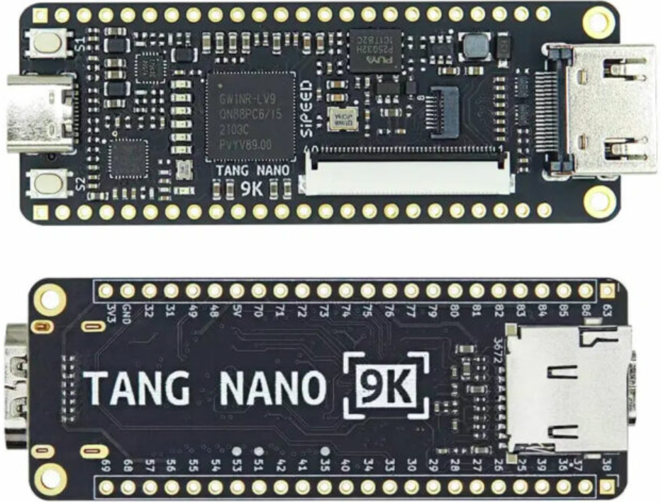
Tang 9K Nano
approximately $13 + shipping
1/15/2023
11
Notes:
Uses Gowin GW1NR-9 FPGA: 8,640 LUTs, 2 push buttons, 6 LEDs, HDMI connector, SD slot, DRAM, Two LCD connectors.
Usually has unsoldered pins. User to solder the pins needed for breadboard use. Many other low cost DIP format FPGA boards available, just not as capable for the price.

Slide 12
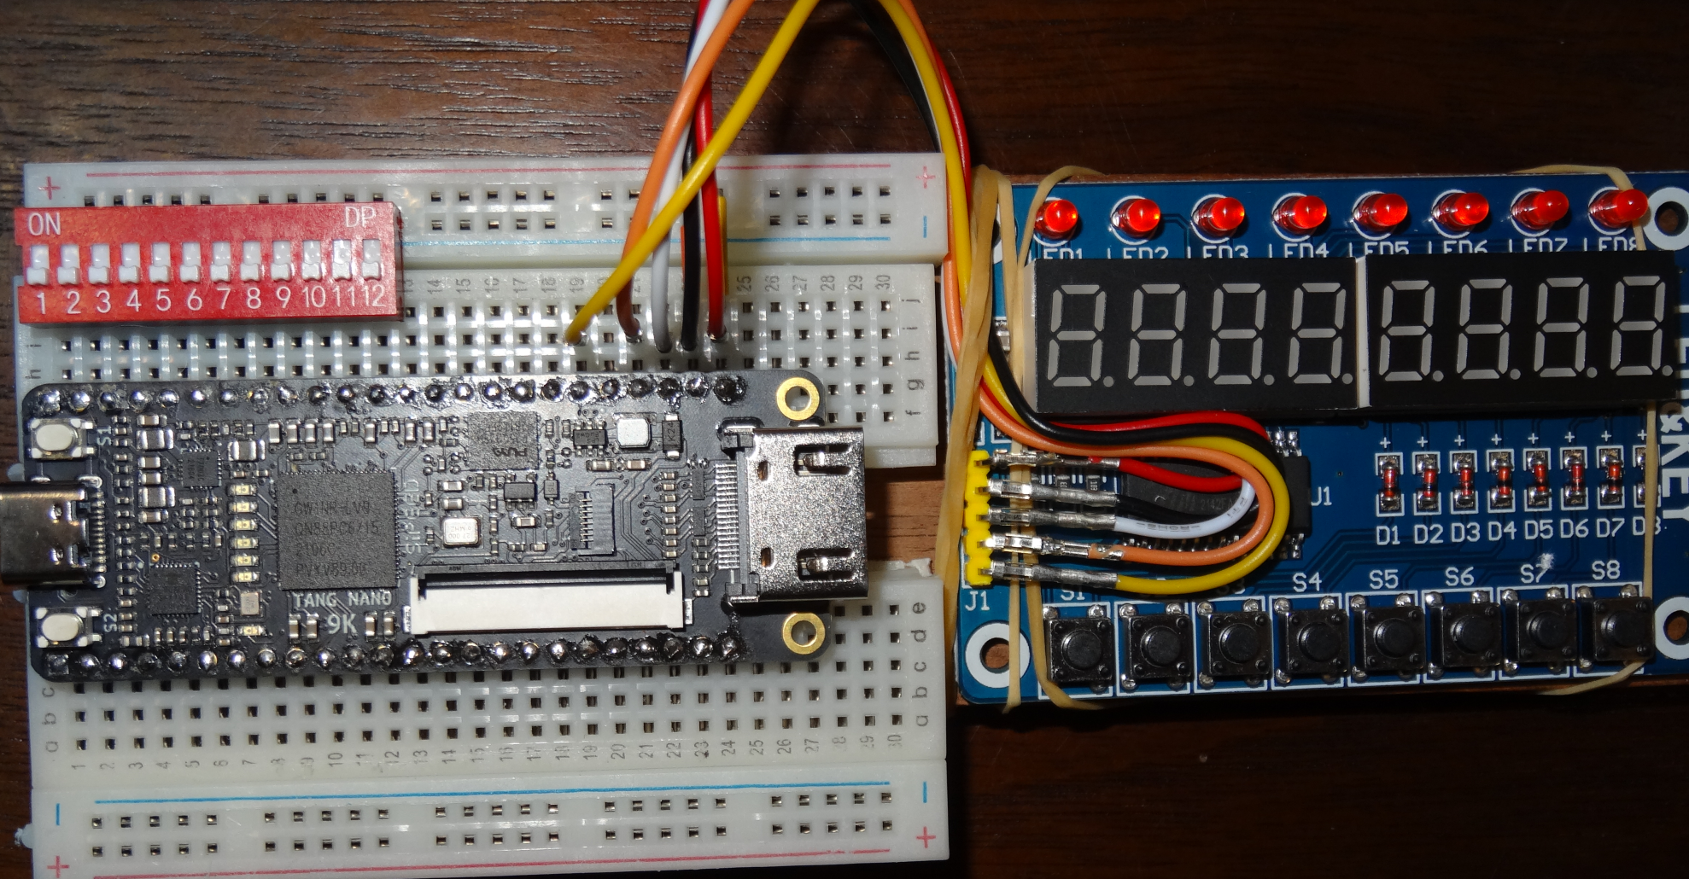
Kit Picture
The kit using the Tang 9K Nano for high volume has a per kit price of $18.51
In low volume (for a single kit) is $25.64 plus shipping and taxes with some
spare parts left over (extra breadboards and jumper wires).
Notes:
Spreadsheet has several sources for each of the items: TBD: Use longer breadboard (as shown above). TBD: Use two five position DIP switches. Be sure to get jumpers with insulated ends. Pricing for thirty kits for a classroom about $20 each plus shipping and taxes.

Slide 13
RTL for driving display
VHDL and Verilog for operating the TM1638 display board available at:
https://github.com/zpekic/Sys_TM1638
https://github.com/alangarf/tm1638-verilog
Notes:
Both flat cable connectors & HDMI connector accessible. Breadboard scored with knife and split allowing access to more breadboard rows. Top power buss rotated 180 degrees and shifted to align with DIP switch pins. Adhesive breadboard backing exposed and mounted on piece of wood.

Slide 14
What is missing
Slides on how to setup your laptop for the Tang 9K board
Courseware for the middle school student
Not planning to produce it
Not my area of expertise
Goal is for the middle school student to get familiar with digital circuits and binary
Preprogram the board so IO pins provide logic gates and connections to on-chip buttons and LEDs
Tutorials:
https://learn.lushaylabs.com/tang-nano-series/
https://wiki.sipeed.com/hardware/en/tang/Tang-Nano-9K/Nano-9K.html
Notes:
By preprogramming the board, students can get “instant gratification” on using logic gates, buttons and LEDs (will require male-male jumpers). Using the display board comes later, again for instant gratification preprogram an example operation using the display board.

Slide 15
LUTs
Performing Boolean Algebra inside an FPGA using Look-Up Tables (LUTs)
https://nandland.com/lesson-4-what-is-a-look-up-table-lut/:
“Note to the reader: many textbooks and classrooms will spend a
significant amount of time discussing how LUTs can be wired to
create the optimal solution to a Boolean expression. Optimal
means that it uses the least number of gates possible. Topics
such as De Morgan’s Law, Karnaugh Maps, the Quine-McCluskey
method, and others are usually discussed at great length that
describe how to optimize digital logic. However I feel that this is
not necessary to begin learning about FPGAs.”
Notes:
The four main user visible components of an FPGA: LUTs, block RAM, D flip-flops and IO pins.

Slide 16
Block RAM tutorial
https://nandland.com/lesson-15-what-is-a-block-ram-bram/
Notes:
The four main user visible components of an FPGA: LUTs, block RAM, D flip-flops and IO pins. The others include clock generators and the DSP/multiply/accumulator.

Slide 17
Educational programs
Intel/Altera academy Quartus: RTL & Schematic
AMD/Xilinx university program ISE & Vivado RTL tools
Courseware for Real Digital Boolean board RTL
https://www.realdigital.org/course/digital-logic-for-the-boolean-board
https://www.tina.com/ (Schematic based, not free)
Support for the Digilent Basys 3 and the Terasic DE10-Lite FPGA boards
https://www.tina.com/blog/programming-fpga-boards-with-tina-using-schematic-design-entry/
Digital logic simulator (Schematic based)
Support for the Digilent Basys 3 and the TinyFPGA-BX boards
https://github.com/hneemann/Digital/
Hundreds of youtube videos and FPGA web articles on the internet
Notes:
RTL: Register transfer language, usually VHDL or Verilog. Quartus and Vivado are mainstream tools with free education variants (reduced FPGA family support). Xilinx ISE not recommended for new users.

Slide 18
FPGA References
Twelve youtube videos on specific FPGA features (uses verilog RTL): https://www.youtube.com/playlist?list=PLEBQazB0HUyT1WmMONxRZn9NmQ_9CIKhb
Three Ages of FPGAs: A Retrospective…, Steve Trimberger, Proc. IEEE v103#3p318, 2015
www.cpe.virginia.edu/grads/pdfs/January%202016/VLSI.pdf
https://www.youtube.com/watch?v=4ntXSyOhlBY
Xilinx Part Family History, John Lazzaro,
www-inst.eecs.berkeley.edu/~cs294-59/fa10/resources/Xilinx-history/Xilinx-history.html
Altera History, corporate, http://www.fundinguniverse.com/company-histories/altera-corporation-history/
Low cost FPGA boards
https://www.joelw.id.au/FPGA/CheapFPGADevelopmentBoards
Open source IP https://opencores.org/projects
Github (open source) projects: search on “github vhdl verilog cpu”
Notes:
http://www.fundinguniverse.com/company-histories has histories of Xilinx and many other companies.

Slide 19
In conclusion
It is thought that ownership of an FPGA board will lead to greater usage and knowledge. As opposed to shared laboratory equipment.
Oriented towards a beginner’s board at the lowest possible cost. Lots of switches, LEDs etc. eliminate need for discrete components and their fragile wiring.
Here we are trading cost for convenience:
$20 versus $70
Some user wiring & soldering ready to use
Unproven FPGA tools mainstream tools
Needs case for transport usable without wiring
Notes:
Files at https://github.com/jimbrake/FPGA_Boot_Camp have a date code suffix and are updated frequently. Currently several universities issue an FPGA board to each student for a one semester course. Am targeting middle school students (and the third world) with this kit,

Slide 20
“Digital” logic simulator
Web site: https://github.com/hneemann/Digital/
Authored by: Helmut.Neemann@mosbach.dhbw.de
Open source, other simulators available
Modified to support the Boolean board
Here, the user can use Digital for simulation
And examine the generated VHDL/Verilog
Notes:
You will probably need to manually generate constraint files for Tang 9K Nano or use the Gowin constraint editor (recommended).

Slide 21
Interactive digital simulation
Schematic editor and simulator
Provides an intermediate step before RTL (Register Transfer Logic) and full FPGA tools.
Requires nothing beyond a PC.
Requires Java
Totally interactive
Generates VHDL or Verilog RTL files
Generates constraint file for vivado (xilinx FPGA tool)
Notes:
The two main RTLs are verilog and VHDL. The most recent verilog is called System Verilog. ASIC people prefer verilog. DOD and Europe like VHDL. There are linting tools that can check your code including adherence to coding standards.

Slide 22
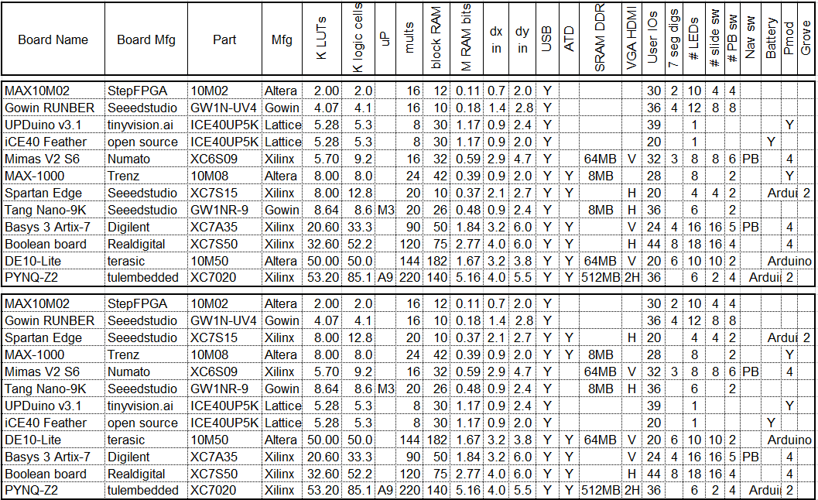
FPGA board rankings
Top version sorted by LUT count, bottom version by block RAM bit count
This listing is only a sample of the hundreds of boards available.
1/15/2023
1/15/2023
22
22

Slide 23
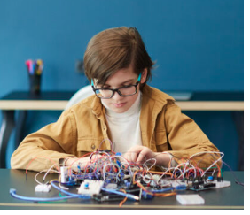
mess of wires not cool any more
In today’s world
most wires are
in the PCB and
In the FPGA !
OK as long as you
don’t need to
move the device
From https://life.ieee.org/
Notes:
For more organized and stable proto-board wiring see a Ben Eater's web page: https://www.reddit.com/r/beneater/comments/w447u3/created_a_random_maze_program_for_my_putey1_ttl/

Slide 24
RTL (Register Transfer Language) VHDL and Verilog are “hardware description” languages
Separates design into combinatorial (logic) and sequential (registers).
For simple designs use a single clock
Tang Nano 9K clock is 27 MHz
Digital will generate slower clocks
Right click on clock icon & set frequency
Digital thinks the clock is 100MHz
Registers update on rising edge clock
Notes:
This FPGA Boot Camp avoids teaching VHDL or Verilog, instead you learn by seeing the VHDL or Verilog generated from your schematic. This is done to get to an easy to use FPGA “flow” (a sequence of actions needed to create and implement a design).

Slide 25
Side by side VHDL and Verilog
Digital generates both
RealDigital’s treatment:
https://www.realdigital.org/downloads/e06bddc63669cbc91ae981df18bcf3c5.pdf
Side by side System-Verilog & VHDL:
Digital Design and Computer Architecture, Harris & Harris, 2nd ed. Also ARM and RISC-V editions
Highly recommended, goes from transistors to PCs
Side by side Verilog & VHDL:
HDL Programming Fundamentals: VHDL and Verilog, Nazeih Botros 2006
Also: https://www.fpga4student.com/2017/08/verilog-vs-vhdl-explain-by-example.html
Notes:
System Verilog is a modern version of Verilog and provides the same capabilities as VHDL.

Slide 26
What FPGA tools do
Much goes on behind the scenes
Circuit is optimized (logic simplification)
unused stuff is pruned, if no outputs then all pruned
Circuit is mapped into FPGA primitives
Circuit wired up with FPGA routing resources
Bit file generated that configures the chip
Error checking especially missing semicolons
Reports on timing, resources used, error messages
A schematic viewer will show chip details
Elaborated Design show’s vivado’s version of schematic
Notes:
FPGA tools are very good at logic optimization and good at interconnecting logic units, not perfect on placement of LUTs and Block RAMs.
Tools allow optimization for speed and area with level of effort controls. Often times optimization for area also gives good speed.
Modern practice is to use a constraint file to set the desired clock speed and let the FPGA tool optimize for that setting.

Slide 27
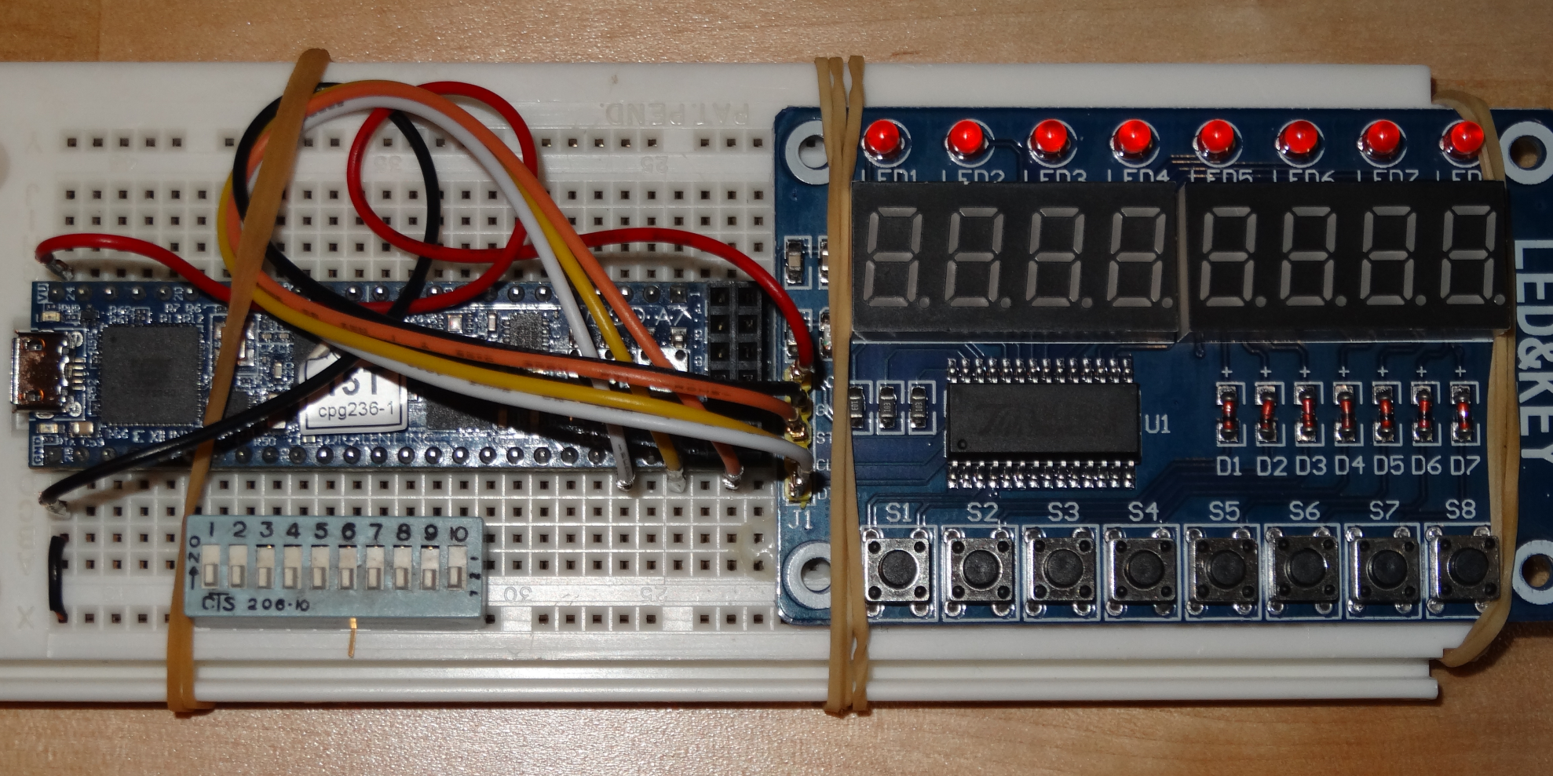
Breadboard example
Cmod A7-15 board from Digilent, DIP switch and TM1638 display board
Pin 6 of DIP switch folded out and not connected
Male-female jumper wires used to connect the display board
Solid wire jumper connects one side of DIP switch to ground
Notes:
Using parts on hand. Cmod A7-15T: https://www.tequipment.net/Digilent/Cmod-A7-15T/. In above picture the jumper ends are not insulated, use ones with insulated ends.

